Slide 1
An Adaptive Calibration Algorithm Using Progressive Measurement and Accelerated Measurement Prediction
Yuxuan Chen

Slide 2
Traditional Method
Computer sends all settings to the DUT (in arbitrary order) for measurement.
A constellation of all settings is generated.
Computer scans all constellation points to find the point closest to the ideal position and establish the mapping.
Advantage:
Highest accuracy and often guaranteed solution.
Measurement order and details of the controls are hidden from the user.
Relaxed requirement for the DUT gain and phase response.
Disadvantage:
Long measurement time and long post-processing time. (Need to measure every point and computer need to scan every point for comparison for every ideal points)
PC
IC

Slide 3
Adaptive Measurements

Slide 4
Adaptive Measurements

Slide 5
Adaptive Measurements
Need bi-directional relationship from DUT settings to the measurement points.
DUT response need to be predictable, and the measurement results need to be near the ideal points.

Slide 6
Outphasing Phase Shifter

Slide 7
Outphasing Phase Shifter

Slide 8
Outphasing Phase Shifter

Slide 9
Outphasing Phase Shifter

Slide 10
Outphasing Phase Shifter

Slide 11
Outphasing Phase Shifter

Slide 12
Outphasing Phase Shifter

Slide 13
Outphasing Phase Shifter

Slide 14
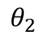
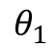
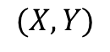
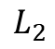
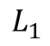
Outphasing Phase Shifter
$$(X, Y)$$
$$L_{2}$$
$$θ_{2}$$
$$L_{1}$$
$$θ_{1}$$

Slide 15
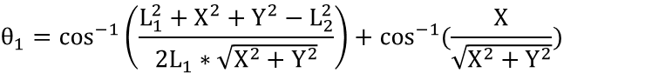
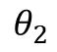
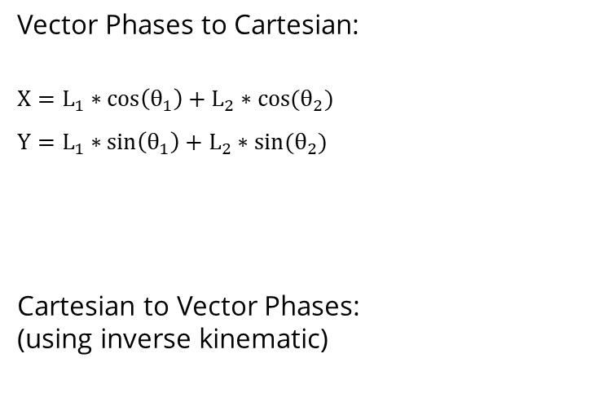
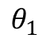
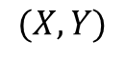
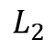

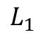
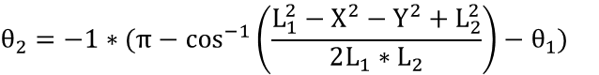
Outphasing Phase Shifter
Vector Phases to Cartesian:
$$X=L_{1}∗\cos\left(θ_{1}\right)+L_{2}∗cos⁡(θ_{2})$$
$$Y=L_{1}∗\sin\left(θ_{1}\right)+L_{2}∗sin⁡(θ_{2})$$
Cartesian to Vector Phases:
(using inverse kinematic)
$$(X, Y)$$
$$L_{2}$$
$$θ_{2}$$
$$L_{1}$$
$$θ_{1}$$
$$For Y≥0:$$
$$θ_{1}=\cos^{−1}\left(\frac{L_{1}^{2}+X^{2}+Y^{2}−L_{2}^{2}}{2L_{1}∗\sqrt{X^{2}+Y^{2}}}\right)+cos^{−1}(\frac{X}{\sqrt{X^{2}+Y^{2}}}){ }$$
$$θ_{2}=−1∗(π−\cos^{−1}\left(\frac{L_{1}^{2}−X^{2}−Y^{2}+L_{2}^{2}}{2L_{1}∗L_{2}}\right)−θ_{1}){ }$$

Slide 16
Outphasing Phase Shifter
Vector Phases to Cartesian:
$$X=L_{1}∗\cos\left(θ_{1}\right)+L_{2}∗cos⁡(θ_{2})$$
$$Y=L_{1}∗\sin\left(θ_{1}\right)+L_{2}∗sin⁡(θ_{2})$$
Cartesian to Vector Phases:
(using inverse kinematic)
$$(X, Y)$$
$$L_{2}$$
$$θ_{2}$$
$$L_{1}$$
$$θ_{1}$$
$$For Y≥0:$$
$$θ_{1}=\cos^{−1}\left(\frac{L_{1}^{2}+X^{2}+Y^{2}−L_{2}^{2}}{2L_{1}∗\sqrt{X^{2}+Y^{2}}}\right)+cos^{−1}(\frac{X}{\sqrt{X^{2}+Y^{2}}}){ }$$
$$θ_{2}=−1∗(π−\cos^{−1}\left(\frac{L_{1}^{2}−X^{2}−Y^{2}+L_{2}^{2}}{2L_{1}∗L_{2}}\right)−θ_{1}){ }$$

Slide 17

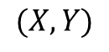


RFVM
Vector lengths to Cartesian:
$$X=L_{I}$$
$$Y=L_{Q}$$
Cartesian to Vector lengths:
$$L_{I}=X$$
$$L_{Q}=Y$$
$$L_{I}$$
$$(X, Y)$$
$$L_{Q}$$

Slide 18
Adaptive Measurements
ideal target point
For an ideal target point, use inverse kinematic to calculate the corresponding two vector phases and obtain the measurements.

Slide 19
Adaptive Measurements
ideal target point
For an ideal target point, use inverse kinematic to calculate the corresponding two vector phases and obtain the measurements.
measurements
If measure all the points for a constant gain circle at once, the distorted circle makes adjustment difficult and reductant measurements are made.

Slide 20
Point-to-Point Progressive Measurements
Phase offset compensation
Target an ideal point of phase 0

Slide 21
Point-to-Point Progressive Measurements
Phase offset compensation
Target an ideal point of phase 0
Iteratively adjust phase offset so that the measurement point aligns with the target point.

Slide 22
Point-to-Point Progressive Measurements
Phase offset compensation
Target an ideal point of phase 0
Iteratively adjust phase offset so that the measurement point aligns with the target point.

Slide 23
Point-to-Point Progressive Measurements
Phase offset compensation
Target an ideal point of phase 0
Iteratively adjust phase offset so that the measurement point aligns with the target point.

Slide 24
Point-to-Point Progressive Measurements
Phase offset compensation
Target an ideal point of phase 0
Iteratively adjust phase offset so that the measurement point aligns with the target point.

Slide 25
Point-to-Point Progressive Measurements
Phase offset compensation
Target an ideal point of phase 0
Iteratively adjust phase offset so that the measurement point aligns with the target point.

Slide 26
Point-to-Point Progressive Measurements
Phase offset compensation
Target an ideal point of phase 0
Iteratively adjust phase offset so that the measurement point aligns with the target point.

Slide 27
Point-to-Point Progressive Measurements
Phase offset compensation
Target an ideal point of phase 0
Iteratively adjust phase offset so that the measurement point aligns with the target point.
Next point calibration
Increment the ideal point by the target phase resolution.

Slide 28
Point-to-Point Progressive Measurements
Phase offset compensation
Target an ideal point of phase 0
Iteratively adjust phase offset so that the measurement point aligns with the target point.
Next point calibration
Increment the ideal point by the target phase resolution.

Slide 29
Point-to-Point Progressive Measurements
Phase offset compensation
Target an ideal point of phase 0
Iteratively adjust phase offset so that the measurement point aligns with the target point.
Next point calibration
Increment the ideal point by the target phase resolution.
Perform measurements in the search area (± actual phase resolution and ± actual gain resolution)

Slide 30
Point-to-Point Progressive Measurements
Phase offset compensation
Target an ideal point of phase 0
Iteratively adjust phase offset so that the measurement point aligns with the target point.
Next point calibration
Increment the ideal point by the target phase resolution.
Perform measurements in the search area (± actual phase resolution and ± actual gain resolution)

Slide 31
Point-to-Point Progressive Measurements
Phase offset compensation
Target an ideal point of phase 0
Iteratively adjust phase offset so that the measurement point aligns with the target point.
Next point calibration
Increment the ideal point by the target phase resolution.
Perform measurements in the search area (± actual phase resolution and ± actual gain resolution).
Find the measurement point in the search area that is closet to the ideal point.

Slide 32
Point-to-Point Progressive Measurements
Phase offset compensation
Target an ideal point of phase 0
Iteratively adjust phase offset so that the measurement point aligns with the target point.
Next point calibration
Increment the ideal point by the target phase resolution.
Perform measurements in the search area (± actual phase resolution and ± actual gain resolution).
Find the measurement point in the search area that is closet to the ideal point.
In the case of deviating measurements, a test is performed to evaluate the search area measurement validity.

Slide 33
Point-to-Point Progressive Measurements
Phase offset compensation
Target an ideal point of phase 0
Iteratively adjust phase offset so that the measurement point aligns with the target point.
Next point calibration
Increment the ideal point by the target phase resolution.
Perform measurements in the search area (± actual phase resolution and ± actual gain resolution).
Find the measurement point in the search area that is closet to the ideal point.
In the case of deviating measurements, a test is performed to evaluate the search area measurement validity.
is targeting point inside the measurement results boundary?

Slide 34
Point-to-Point Progressive Measurements
Phase offset compensation
Target an ideal point of phase 0
Iteratively adjust phase offset so that the measurement point aligns with the target point.
Next point calibration
Increment the ideal point by the target phase resolution.
Perform measurements in the search area (± actual phase resolution and ± actual gain resolution).
Find the measurement point in the search area that is closet to the ideal point.
In the case of deviating measurements, a test is performed to evaluate the search area measurement validity.
The error vectors for every ideal/measurement pair are averaged and a new search area is found in the opposite direction.

Slide 35
Point-to-Point Progressive Measurements
Phase offset compensation
Target an ideal point of phase 0
Iteratively adjust phase offset so that the measurement point aligns with the target point.
Next point calibration
Increment the ideal point by the target phase resolution.
Perform measurements in the search area (± actual phase resolution and ± actual gain resolution).
Find the measurement point in the search area that is closet to the ideal point.
In the case of deviating measurements, a test is performed to evaluate the search area measurement validity.
The error vectors for every ideal/measurement pair are averaged and a new search area is found in the opposite direction.

Slide 36
Point-to-Point Progressive Measurements
Phase offset compensation
Target an ideal point of phase 0
Iteratively adjust phase offset so that the measurement point aligns with the target point.
Next point calibration
Increment the ideal point by the target phase resolution.
Perform measurements in the search area (± actual phase resolution and ± actual gain resolution).
Find the measurement point in the search area that is closet to the ideal point.
In the case of deviating measurements, a test is performed to evaluate the search area measurement validity.
The error vectors for every ideal/measurement pair are averaged and a new search area is found in the opposite direction.

Slide 37
Point-to-Point Progressive Measurements

Slide 38
Point-to-Point Progressive Measurements
Phase offset compensation
Target an ideal point of phase 0
Iteratively adjust phase offset so that the measurement point aligns with the target point.
Next point calibration
Increment the ideal point by the target phase resolution.
Perform measurements in the search area (± actual phase resolution and ± actual gain resolution).
Find the measurement point in the search area that is closet to the ideal point.
In the case of deviating measurements, a test is performed to evaluate the search area measurement validity.
The error vectors for every ideal/measurement pair are averaged and a new search area is found in the opposite direction.

Slide 39
Point-to-Point Progressive Measurements
Phase offset compensation
Target an ideal point of phase 0
Iteratively adjust phase offset so that the measurement point aligns with the target point.
Next point calibration
Increment the ideal point by the target phase resolution.
Perform measurements in the search area (± actual phase resolution and ± actual gain resolution).
Find the measurement point in the search area that is closet to the ideal point.
In the case of deviating measurements, a test is performed to evaluate the search area measurement validity.
The error vectors for every ideal/measurement pair are averaged and a new search area is found in the opposite direction.

Slide 40
RTPS Phase Switching Modes
RTPS 1
RTPS 2
RTPS 3
RTPS 1
RTPS 2
RTPS 3

Slide 41
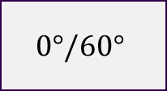
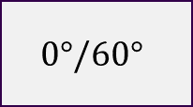
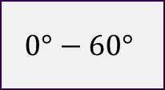



RTPS Phase Switching Modes
$$0°−60°$$
$$0°/60°$$
$$0°/60°$$
$$0°−60°$$
$$0°/60°$$
$$0°/60°$$

Slide 42




RTPS Phase Switching Modes
$$0°/60°$$
$$0°−60°$$
$$0°/60°$$
$$0°/60°$$
$$0°−60°$$
$$0°/60°$$

Slide 43
RTPS Phase Switching Modes
$$0°−60°$$
$$0°/60°$$
$$0°/60°$$
$$0°/60°$$
$$0°−60°$$
$$0°/60°$$

Slide 44
RTPS Phase Switching Modes
9 Modes for a pair of phase setting.
Due to PVT variation and mismatch, the constellation of the 9 modes are slightly different.
Provide fine tune to the constellation point.
Due to the random nature of this variation, this effect cannot be learned.
RTPS 1
RTPS 2
RTPS 3
RTPS 1
RTPS 2
RTPS 3

Slide 45
Point-to-Point Progressive Measurements
Phase offset compensation
Target an ideal point of phase 0
Iteratively adjust phase offset so that the measurement point aligns with the target point.
Next point calibration
Increment the ideal point by the target phase resolution.
Perform measurements in the search area (± actual phase resolution and ± actual gain resolution).
Find the measurement point in the search area that is closet to the ideal point.
In the case of deviating measurements, a test is performed to evaluate the search area measurement validity.
The error vectors for every ideal/measurement pair are averaged and a new search area is found in the opposite direction.

Slide 46
Point-to-Point Progressive Measurements
Phase offset compensation
Target an ideal point of phase 0
Iteratively adjust phase offset so that the measurement point aligns with the target point.
Next point calibration
Increment the ideal point by the target phase resolution.
Perform measurements in the search area (± actual phase resolution and ± actual gain resolution).
Find the measurement point in the search area that is closet to the ideal point.
In the case of deviating measurements, a test is performed to evaluate the search area measurement validity.
The error vectors for every ideal/measurement pair are averaged and a new search area is found in the opposite direction.

Slide 47
Point-to-Point Progressive Measurements
Phase offset compensation
Target an ideal point of phase 0
Iteratively adjust phase offset so that the measurement point aligns with the target point.
Next point calibration
Increment the ideal point by the target phase resolution.
Perform measurements in the search area (± actual phase resolution and ± actual gain resolution).
Find the measurement point in the search area that is closet to the ideal point.
In the case of deviating measurements, a test is performed to evaluate the search area measurement validity.
The error vectors for every ideal/measurement pair are averaged and a new search area is found in the opposite direction.

Slide 48
Point-to-Point Progressive Measurements
Phase offset compensation
Target an ideal point of phase 0
Iteratively adjust phase offset so that the measurement point aligns with the target point.
Next point calibration
Increment the ideal point by the target phase resolution.
Perform measurements in the search area (± actual phase resolution and ± actual gain resolution).
Find the measurement point in the search area that is closet to the ideal point.
In the case of deviating measurements, a test is performed to evaluate the search area measurement validity.
The error vectors for every ideal/measurement pair are averaged and a new search area is found in the opposite direction.
Measure the 9 modes and find the closest point to the ideal point.

Slide 49
Point-to-Point Progressive Measurements
Phase offset compensation
Target an ideal point of phase 0
Iteratively adjust phase offset so that the measurement point aligns with the target point.
Next point calibration
Increment the ideal point by the target phase resolution.
Perform measurements in the search area (± actual phase resolution and ± actual gain resolution).
Find the measurement point in the search area that is closet to the ideal point.
In the case of deviating measurements, a test is performed to evaluate the search area measurement validity.
The error vectors for every ideal/measurement pair are averaged and a new search area is found in the opposite direction.
Measure the 9 modes and find the closest point to the ideal point.

Slide 50
Point-to-Point Progressive Measurements
Phase offset compensation
Target an ideal point of phase 0
Iteratively adjust phase offset so that the measurement point aligns with the target point.
Next point calibration
Increment the ideal point by the target phase resolution.
Perform measurements in the search area (± actual phase resolution and ± actual gain resolution).
Find the measurement point in the search area that is closet to the ideal point.
In the case of deviating measurements, a test is performed to evaluate the search area measurement validity.
The error vectors for every ideal/measurement pair are averaged and a new search area is found in the opposite direction.
Measure the 9 modes and find the closest point to the ideal point.
Establish mapping between the codeword of the closest point to the position of the ideal point.

Slide 51
Point-to-Point Progressive Measurements
Phase offset compensation
Target an ideal point of phase 0
Iteratively adjust phase offset so that the measurement point aligns with the target point.
Next point calibration
Increment the ideal point by the target phase resolution.
Perform measurements in the search area (± actual phase resolution and ± actual gain resolution).
Find the measurement point in the search area that is closet to the ideal point.
In the case of deviating measurements, a test is performed to evaluate the search area measurement validity.
The error vectors for every ideal/measurement pair are averaged and a new search area is found in the opposite direction.
Measure the 9 modes and find the closest point to the ideal point.
Establish mapping between the codeword of the closest point to the position of the ideal point.
Repeat 2 until all ideal points on this gain circle are calibrated.

Slide 52
Point-to-Point Progressive Measurements
Remarks:
Progressive measurement is repeated for every needed constant gain circle.
The step of phase offset compensation should be done after DC offset compensation and vector length measurement.
All measurement results in the search area are saved so that there is no need for repetitive measurement when accessed again.

Slide 53
Accelerated Measurement Prediction

Slide 54
Accelerated Measurement Prediction

Slide 55
Accelerated Measurement Prediction

Slide 56
Accelerated Measurement Prediction

Slide 57
Accelerated Measurement Prediction
Mapping

Slide 58
Accelerated Measurement Prediction

Slide 59
Accelerated Measurement Prediction

Slide 60
Accelerated Measurement Prediction

Slide 61
Accelerated Measurement Prediction

Slide 62
Accelerated Measurement Prediction

Slide 63
Accelerated Measurement Prediction

Slide 64
Accelerated Measurement Prediction

Slide 65
Accelerated Measurement Prediction

Slide 66
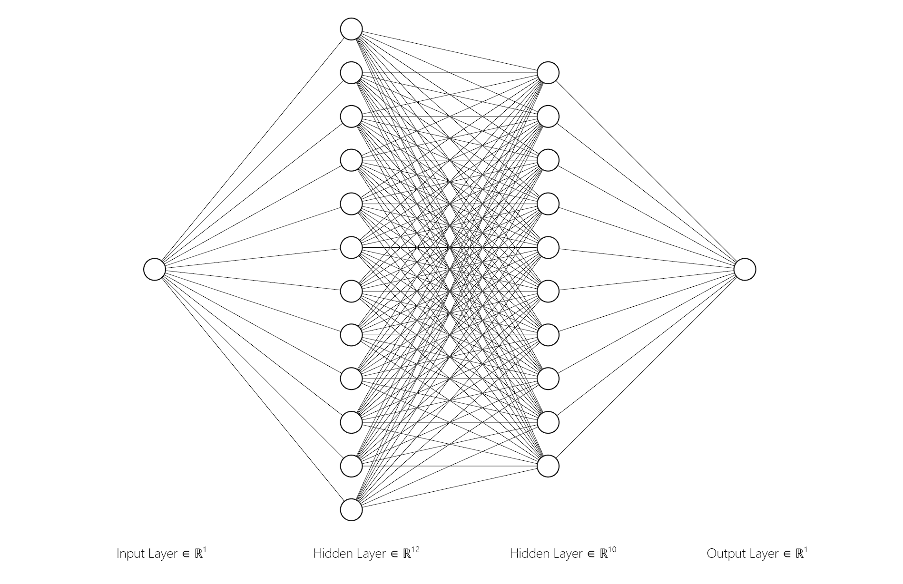
Accelerated Measurement Prediction
Ideal Position that results in the closest measurement to the target position
Target Position

Slide 67
Accelerated Measurement Prediction
In-situ training and validating
Ideal Position that results in the closest measurement to the target position
Target Position

Slide 68
Accelerated Measurement Prediction

Slide 69
Accelerated Measurement Prediction

Slide 70
Accelerated Measurement Prediction

Slide 71
Accelerated Measurement Prediction

Slide 72
Accelerated Measurement Prediction
Progressive training per gain circle.
Neural Network replaces the normal routine after making 5 correct prediction in a row.
When the network is not validated, a new targeting point is fed to the neural network for testing before it is used for training so that the testing data has not been trained by the network.
Neural Network prediction is verified by doing the 9 mode measurements and judge if the closet point is close enough (by previous standard).
If Neural Network prediction is checked to be inaccurate, the current targeting point is calibrated using the normal routine and the neural network restart training.
In-situ training and validating
Ideal Position that results in the closest measurement to the target position
Target Position

Slide 74
Thank you

Slide 75
An Adaptive Calibration Algorithm Using Progressive Measurement and Accelerated Measurement Prediction
Development Update 1
Yuxuan Chen

Slide 76
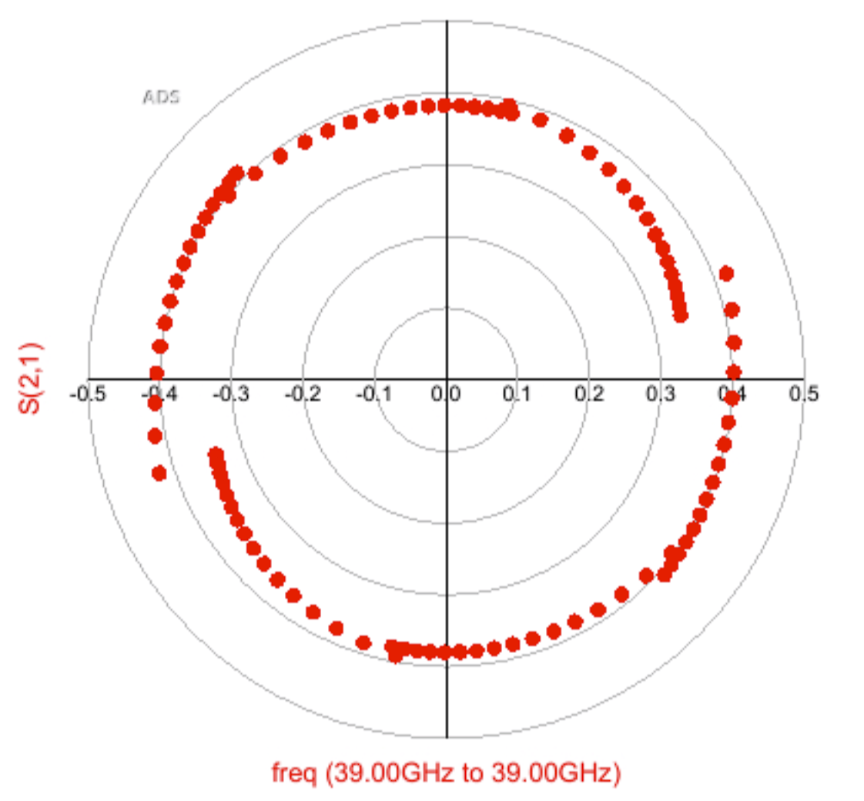
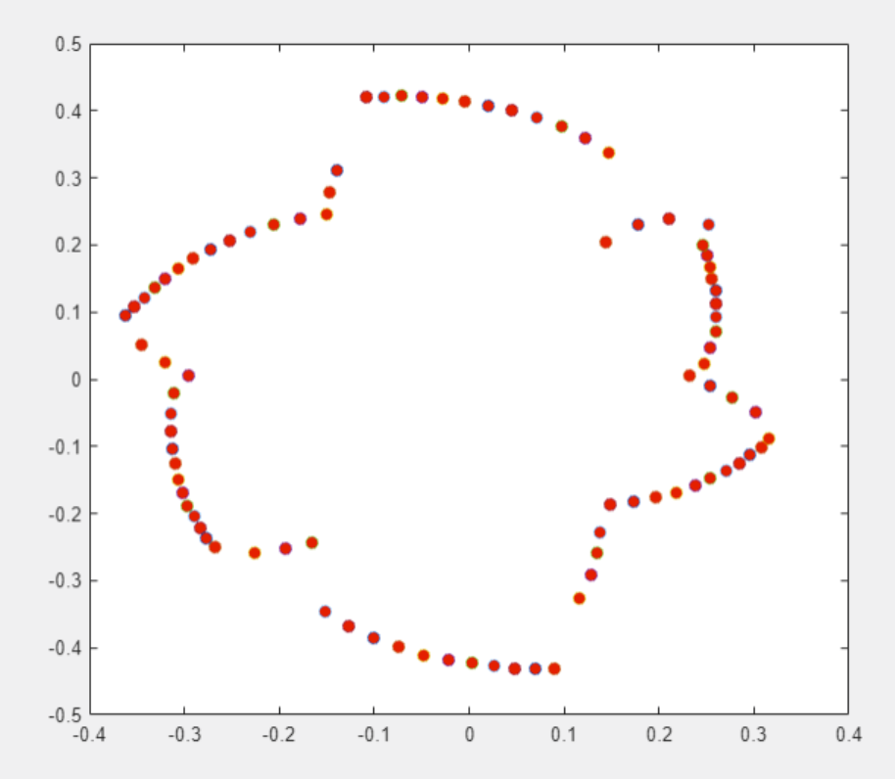
Measurement non-uniformity causes distortion in constant gain circle

Slide 77
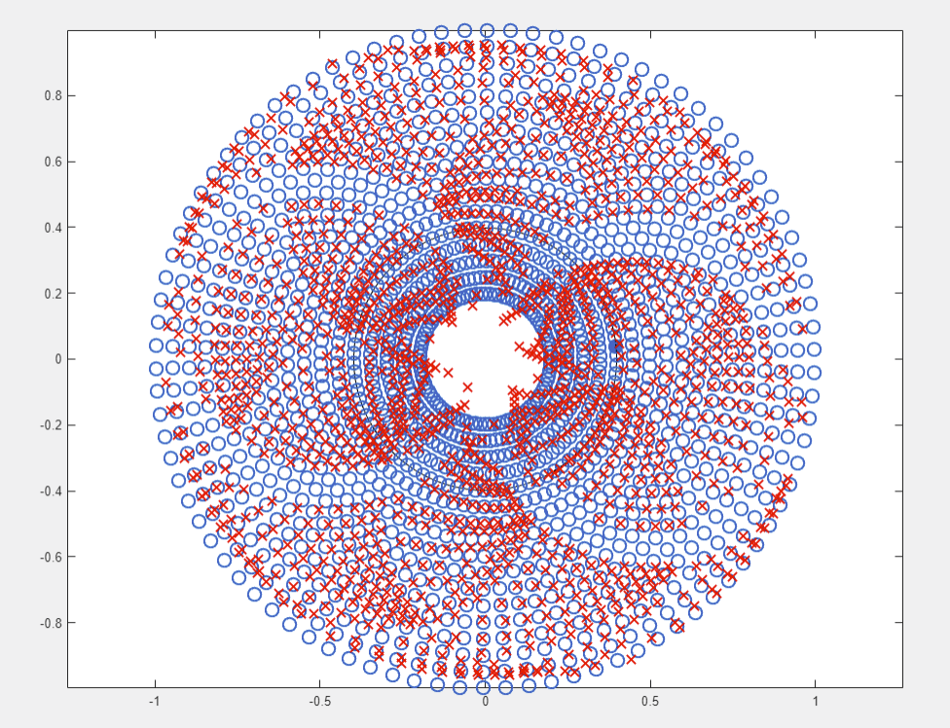
Measurement Dead zones

Slide 78
Demo

